Slide 1


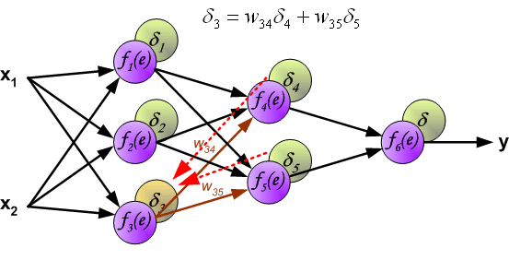

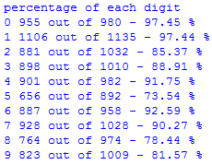
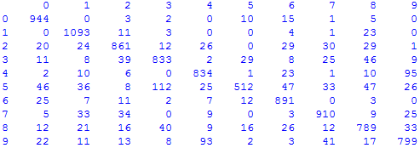
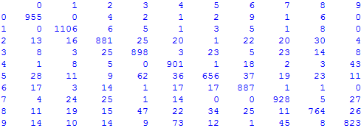
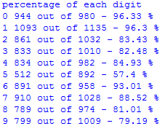
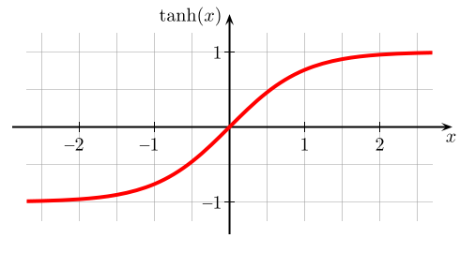
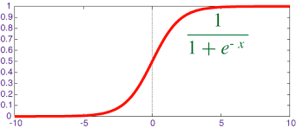
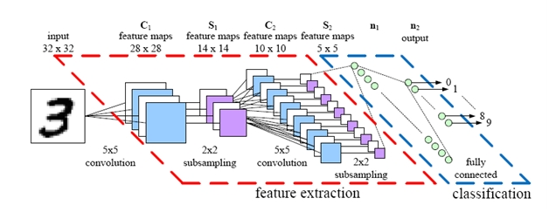
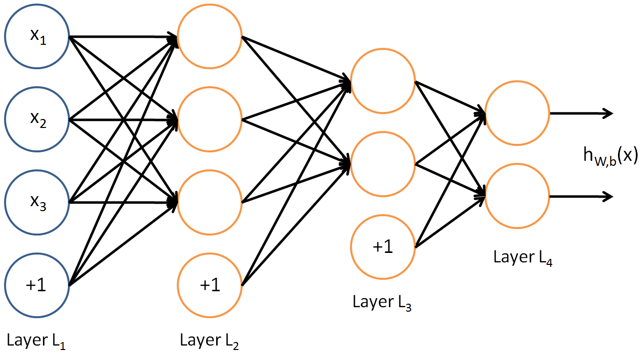
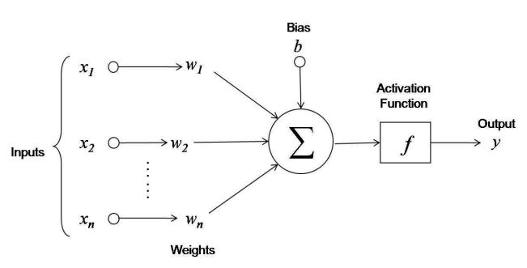

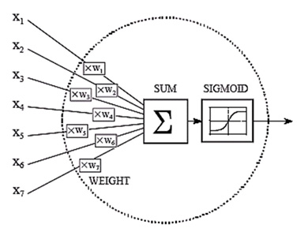
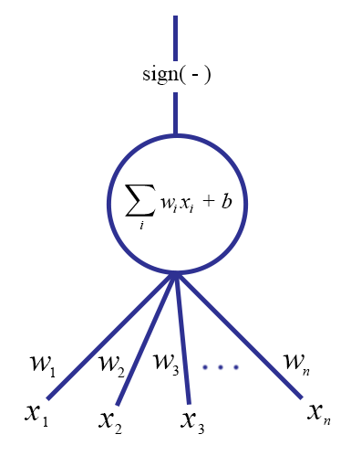


OMG! My Computer has a Brain!: Artificial Neural Networks (ANNs)
Demetris Coleman¹, Stefan Lee², David Crandall²
¹Auburn University
²Indiana University
Abstract
Methods
Data & Results (continued)
Today, artificial neural networks are at the forefront of machine learning. The idea of artificial neural network software is loosely based on the concept of biological neurons. There are many different types that are used in applications such as computer vision, stock market prediction, handwriting and character recognition, and audio processing. In this research, the objective was to learn about and implement a classical feed forward neural network in order to gain a deep understanding of how they work.
Researched single and multilayered ANNs
Backpropagation
Gradient descent
Created ANN Library
Tested on simple logic gates
Tested on Iris data set [5]
Tested on MNIST [4] data set
Actual VS. Predicted Digit Labels
Actual
Labels
Predicted Labels
Training
Learning rate- α
Momentum- η
Actual VS. Predicted Digit Labels
Actual
Labels
Predicted Labels
Confusion matrix and percentage correct for each digit in 500, 150 (right, total correct: 84.66%) and 300, 100 (left, total correct: 87.99%) networks.
Hyperbolic tangent (left) and Sigmoid (right) activation functions.
Visual of convolutional neural network (below).
Feed Inputs Forward
Future Work
Backpropagate Errors
Visual of single neuron with external bias (above left), single neuron with built in bias (above right), and backpropagation equations (below).
Geolocation
Expand code to include CNN and RNN
Implement code in more optimized language
Study possibility of self-changing/pruning
Study adaptive learning rates
Use to program robots
Visual of simple feed forward neural network (above), single neuron with external bias (below left), and single neuron with built in bias (below right).
Weight Change Formula
For Output Neuron
For Hidden Neuron
Acknowledgements
Bias Change Formula
A special thanks to:
National Science Foundation
(through CAREER IIS-1253549)
Dr. Lamara Warren
Dr. David Crandall
Stefan Lee
Introduction
Data & Results
Iris Classifier- classifies between three types of iris flowers with over 90% accuracy after few minutes of training
Logic gates- can learn a few with no hidden layers
MNIST data base- After several days of training, correctly classifies 88% of the 10,000 handwritten digits in the test set using a network 2 hidden layers (300 nodes in 1st, 100 in 2nd) and 84% using a similar network with 500 nodes in 1st hidden layer and 150 in 2nd .
References
There are many types of ANN. The main two classifications are feed forward and recurrent.
[1.] Anil K., Jain. “Artificial Neural Networks: A Tutorial”. Proc. IEEE,
March 1996
[2.]Tanner, Tuhran. “Neural Networks and Computation”. Rock
Solid Images, 1995
[3.]LeCun, Bottou, Orr. “Efficient Backprop”. Springer, 1998
[4.]LeCun, Bottou, Bengio. “Gradient-Based Descent Applied to
Document Recognition” Proc. IEEE, Nov. 1998
[5.]UCI website, http://archive.ics.uci.edu/ml/datasets/Iris
[6.] Makin. "Backpropagation." Unpublished notes, 2006.
Problem Types
Classification
Linear Regression
Key Applications
Computer Vision
Audio Processing
Letter Recognition

