Slide 1
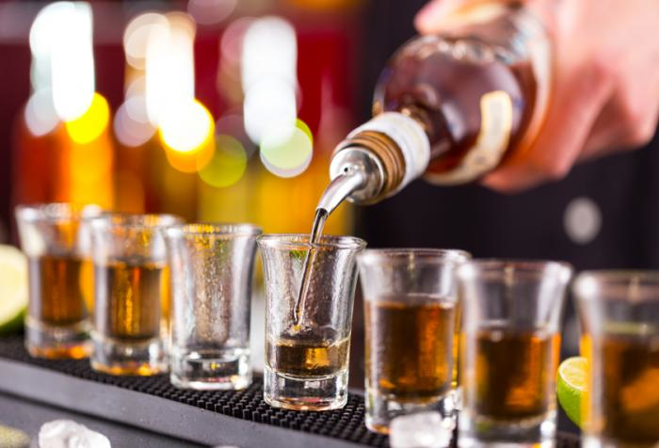
BINGE DRINKING
Demetris Coleman, Auburn University ‘17
Maria Ramos, University of Puerto Rico ‘18
Sydney Carr, University of Connecticut ‘18mos

Slide 2
Agenda
Background
Introduction
Hypothesis
Variables
Data Analysis
Interpretation of Findings
Conclusion

Slide 3
Background
National Institute on Alcohol Abuse and Alcoholism defines binge drinking as a pattern of drinking that brings a person’s blood alcohol concentration (BAC) to 0.08 grams percent or above.
1/6 Adults-4/month-8 drink
18–34, 70% by 26 and older
77% of $249 billion in 2010 from losses in productivity, health care, crime, and other expense

Slide 4
Introduction
Between 1993 and 2001, the total number of binge-drinking episodes among US adults increased from approximately 1.2 billion to 1.5 billion (Naimi, Brewer, Mokdad, Denny, Serdula, & Marks 2003).
Research Question: What factors are associated with binge drinking?
Sub- question: Are race, gender, and country of origin factors that can be related to binge drinking?

Slide 5
Hypothesis
Hypothesis: It can be argued that these three factors influence the rate at which binge drinking occurs among adults.
Variables: Dependent & Independents
Methods: Chi square & Mosaic plot

Slide 6
Variables
Dependent Variable | Key Variables | Independent Variables
Binge drinking N=2889 | Race N=2889 | White n=1296
 |  | Latino n=851
 |  | Black n=631
 |  | Other n=111
 | Gender N=2889 | Female n=1466
 |  | Male n=1423
 | Country of Origin N=2832 | USA n=2144
 |  | Hispanic n=537
 |  | Other n=151
All the variables were analyzed with the same method.

Slide 7
Data Analysis: Race
Articles contradict each other.
Latinos drink at similar rates as the white population.
Literature shows that the black population drinks less.
P-value= 0.878 > 0.05 (alpha)
X-squared = 0.67951, df = 3
We reject the alternative hypothesis

Slide 8
Data Analysis: Race

Slide 9
Data Analysis: Gender
The The 1992 Longitudinal Alcohol Epidemiologic Survey shows that men were three times more likely to have a diagnosis of alcohol abuse or dependence than were women (Brady and Randall 1999).
P-value= 0.03143 < 0.05 (alpha)
X-squared= 4.693, df= 1
We accept the alternative hypothesis

Slide 10
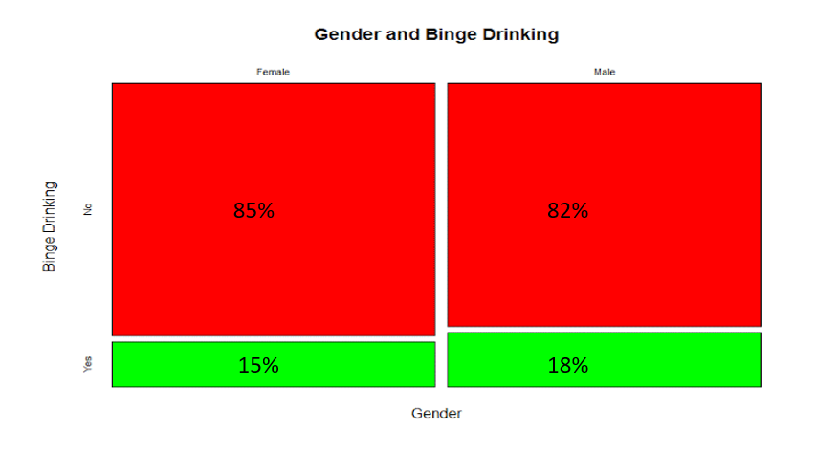
Data Analysis: Gender

Slide 11
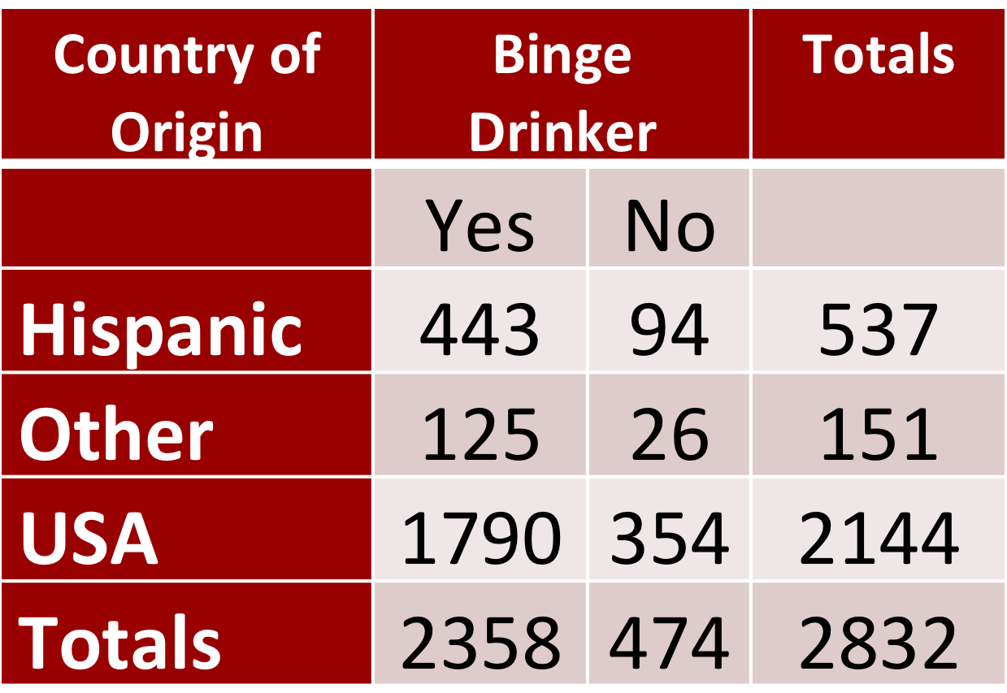
Data Analysis: Country of Origin
Key Assumptions
Chi Squared test
N= 2832
x-squared= 0.33065
Specific countries info not offered
p-value=.8476 We reject the research hypothesis

Slide 12
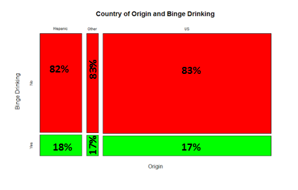
Data Analysis: Country of Origin

Slide 13
Interpretation of the Findings
Men on average drink more than women
All racial/ethnic drink roughly at the same rate
Country of Origin has no significant effect
Disclaimers

Slide 14
Conclusion
For this study:
Race and Country of Origin: The p-value is greater than the alpha value. Therefore, there is not enough information to conclude that race/country of origin are associated with binge drinking.
Gender: The p-value is less than the alpha value. Therefore, there is enough information to conclude that gender is a factor associated with binge drinking.

