Slide 1
Comparing Soft Actuators for
Enhancing MRI Pituitary Tumor Detection
By
Demetris Coleman
Auburn University

Slide 2
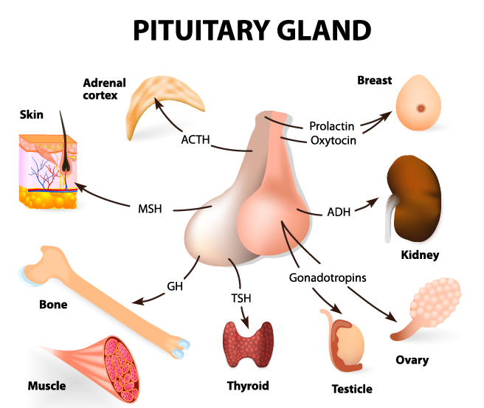
Pituitary Tumors
Symptoms
Menstrual cycle changes
Erectile dysfunction
Production of breast milk by a woman who has not given birth
Accelerated or stunted growth in a child or teenager
Growth of the hands, feet, forehead and jaw in adults
Figure 1: Pituitary gland and parts of the body controlled by it

Slide 3
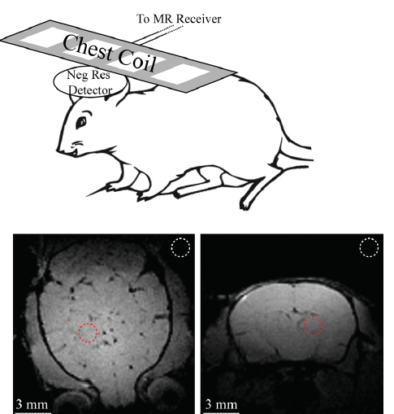
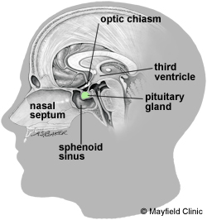
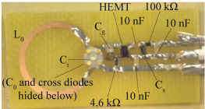
More Background
In 2015, Dr. Chunqi Qian et al improved on a passive coil using inductive coupling that could show a localized image in an MRI machine.
RQ: Can we make a biomaterial to safely place a coil in the sphenoid sinus to better detect pituitary tumors?
Figure 2: Depiction of coil used on rat (a), and MRI scans of rat brain (b)
More specifically… A material that:
can safely enter the human body
fit through the nasal cavities
will not affect MRI machine imaging
place a coil near the pituitary tumor
Figure 3: Coil from Dr. Qian et al, 2015 (left) and Sphenoid sinus in relation to Pituitary gland (right).

Slide 4
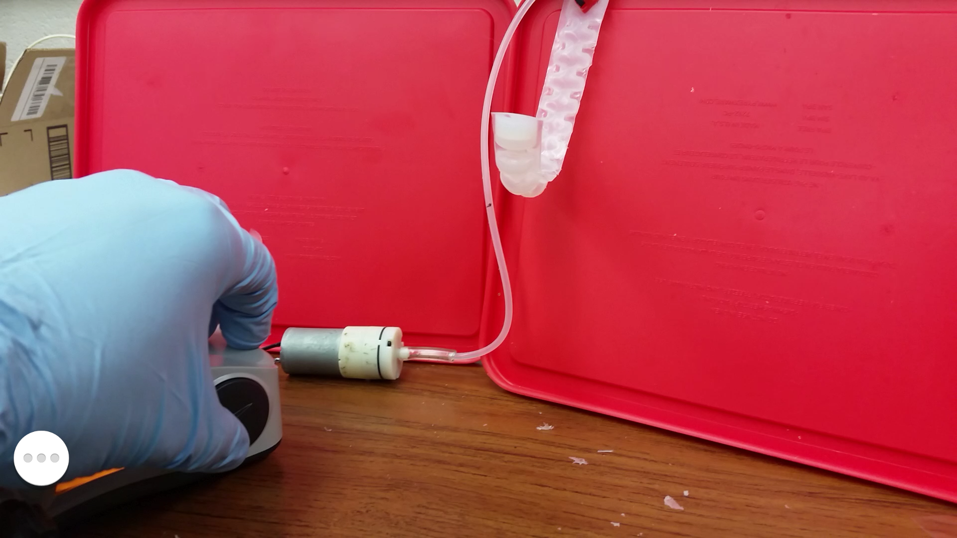
Methods and Materials
Shape Memory Polymer (SMP)
3D printed
Carbon Nanotube (CNT-SMP composite)
Pneumatic Actuators (PNA)
Select Material
Fabricate
Large models for proof of concept
Test small model in replica of nasal structure
Figure 4: 3D Printed SMP actuated in 70 °C water bath
Figure 5: PNA being actuated by electric pump

Slide 5
Details of Testing
Table 1: Measurements and Variables of Interest
Material | Peak Curvature | Tg (C) | Freq | Hardness | Toxic | Pressure | Heat Capacity (C) | Reaches Destination*
3D SMP | 43 | F1~57 F2~38 M~2 | NA | Shore D 82 Shore A 95 Shore A 28 | No | NA | 60 | x
SMP-CNT* | X | ~45 | X | Shore D 75 | X | NA | X | X
PNA | x | NA | NA | Shore A 30 | No | x | NA | X

Slide 6
Results

Slide 7
Conclusion
Table 2: Evaluating which material would be best for the task
 | 3D Printed SMP | SMP-CNT Composite | Pneumatic Actuator
Advantages | Easiest to Reproduce and easily modifiable | Remote control capabilities | Easy to control
Disadvantages | Least control | Not easily obtained | Fabrication can be tedious

Slide 8
Future Work
Hardness and Elasticity Measurements for Tissue and Cartilage
Materials that mimic the cartilage and tissue
Alternative destinations and areas of interest
Expandable Coil
Improve Model

Slide 9
References
[1] "What are pituitary tumors? | American Cancer Society", Cancer.org, 2016. [Online]. Available: http://www.cancer.org/cancer/pituitarytumors/detailedguide/pituitary-tumors-what-is-pituitary-tumor. [Accessed: 27- Jun- 2016].
[2] "Pituitary Tumors | Johns Hopkins Medicine Health Library", Hopkinsmedicine.org, 2016. [Online]. Available: http://www.hopkinsmedicine.org/healthlibrary/conditions/endocrinology/pituitary_tumors_85,P00424/. [Accessed: 27- Jun- 2016].
[3] C. Qian, Q. Duan, S. Dodd, A. Koretsky and J. Murphy-Boesch, "Sensitivity Enhancement of an Inductively Coupled Local Detector Using a HEMT-Based Current Amplifier", Magnetic Resonance in Medicine, vol. 75, no. 6, pp. 2573-2578, 2015.
[4] J. Leng, X. Lan, Y. Liu and S. Du, "Shape-memory polymers and their composites: Stimulus methods and applications", Progress in Materials Science, vol. 56, no. 7, pp. 1077-1135, 2011.
[5] K. Yu, Y. Liu and J. Leng, "Shape memory polymer/CNT composites and their microwave induced shape memory behaviors", RSC Adv., vol. 4, no. 6, pp. 2961-2968, 2014.
[6] S. Wakimoto, K. Ogura, K. Suzumori and Y. Nishioka, "Miniature Soft Hand with Curling Rubber Pneumatic Actuators", Robotics and Automation, pp. 556 - 561, 2009.
[7] J. Wu, C. Yuan, Z. Ding, M. Isakov, Y. Mao, T. Wang, M. Dunn and H. Qi, "Multi-shape active composites by 3D printing of digital shape memory polymers", Sci. Rep., vol. 6, p. 24224, 2016.
[8] M. Spine, "Pituitary tumors, adenoma, craniopharyngioma, rathke cyst", Mayfieldclinic.com, 2016. [Online]. Available: http://www.mayfieldclinic.com/PE-Pit.htm#. [Accessed: 04- Jul- 2016].

Slide 10
Questions?

