Slide 1
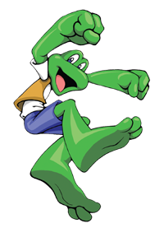
Frogger
ELEC3040 Final Project

Slide 2
Objectives
Create a Player Controlled Character
Generate Auditory Feedback
Randomly Generated Conflict
Specified States
Recorded Score
Scaled Difficulty

Slide 3
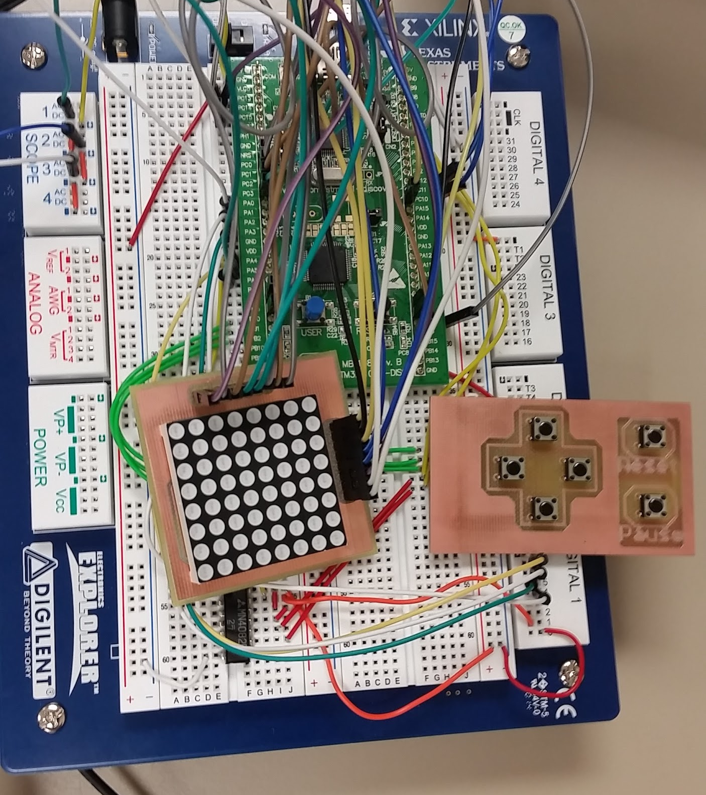
Hardware
STM32L100
Directional Pad
Scanning Algorithm
LED Matrix
Controlled by timer

Slide 4
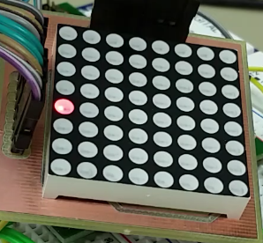
Player Controlled Character
Controlled by Directional Pad
Represented by LED Matrix
Notes:
Justin

Slide 5
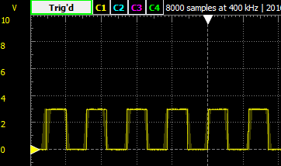
Auditory Feedback
Square Wave Generation
Musical Notes
Note | Frequency of Square Wave
A | 440.00 Hz
B | 493.66 Hz
C | 523.25 Hz
D | 587.33 Hz
E | 659.25 Hz
Notes:
Justin

Slide 6
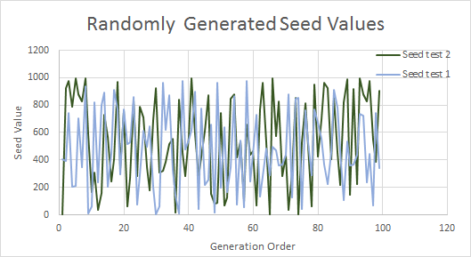
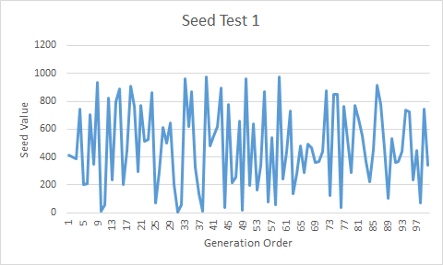
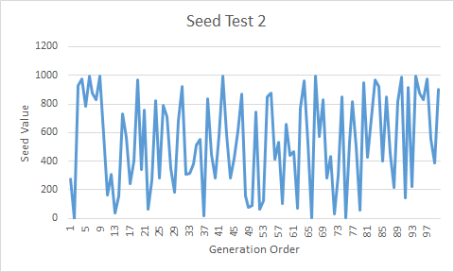
Randomly Generated Conflict
“Random” Generator
Cars
Varying Seed Number

Slide 7
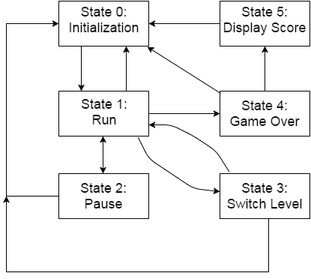
Game States
State | Function
0 | Set character to start position, plays song, clear screen
1 | Allows player to move character and press pause
2 | Freezes game
3 | Increases score and difficulty
4 | Stops all functionality and sends game to state 5
5 | Resets difficulty and score, displays scrolling score.

Slide 8
Recorded Score and Scaled Difficulty
Global Variables
Score Incrementation Based on Difficulty
Score Feedback
Notes:
Justin

Slide 9
Results
Notes:
Justin

Slide 10
Future Work
Miniature Arcade - Additional Simple Games
Additional Difficulty Settings
Improved Hardware
Notes:
Removed questions slide

